Slide 1


Real Time User Engagement and Analytics
Presented by: Pranitha Bollepalli

Slide 2

Project Objectives and Scope
Objective: Real-time insights into social media engagement.
Scope: Community interactions, live streaming, video interactions.
Technologies: Apache Kafka, Spark, AWS S3, Snowflake, Metabase.
Outcome: Interactive dashboards

Slide 3
End-to-End Flow
Components:
Data Sources,
Kafka
S3
Spark
Snowflake
Metabase.
Data Flow:
Ingestion → Cleaning → Transformation → Storage → Visualization.

Slide 4
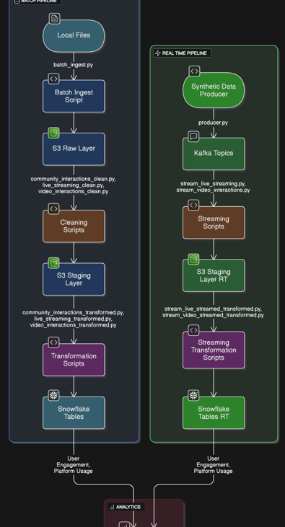
Data Pipeline
Ingestion: Batch (Parquet, CSV, NDJSON) and streaming (Kafka) to S3.
Cleaning: Spark handles nulls, standardization, deduplication.
Transformation: Star schema creation in Spark, load to Snowflake.
Visualization: Metabase dashboards

Slide 5
Dimensional Modeling
Fact Tables: Community Interactions, Live Streaming, Video Interactions, User Activity.
Dimension Tables: User, Community, Platform, Time, Device Type, etc.
Relationships: Surrogate keys link facts to dimensions.
Benefits: Optimized for analytical queries, scalable.

Slide 6
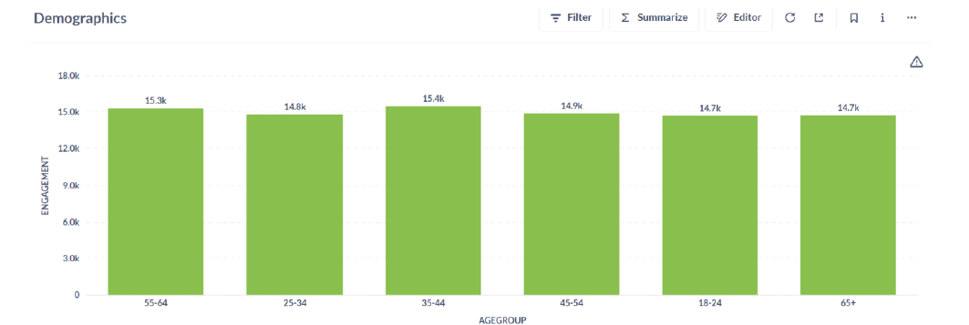
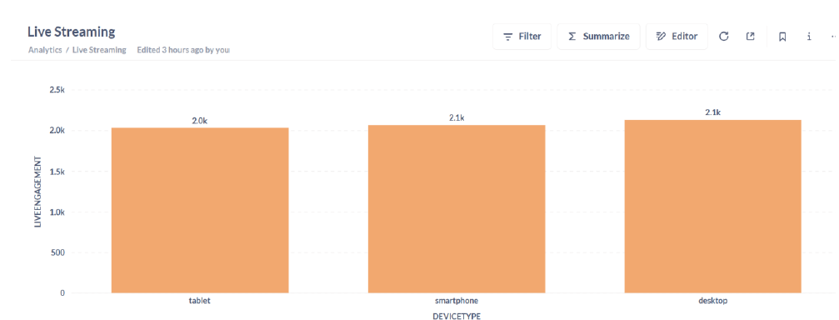
Visualization

Slide 7
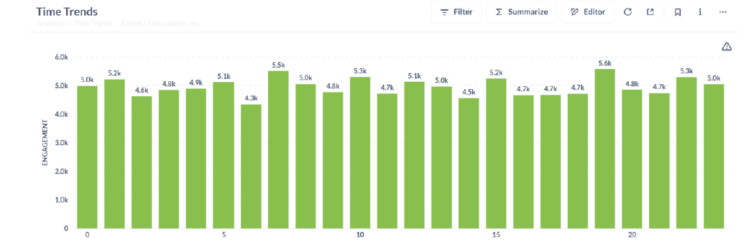
Visualization

Slide 8
Conclusion
The Real-Time User Engagement and Analytics project delivers a robust pipeline for processing and visualizing high-velocity social media data. By integrating Kafka, Spark, S3, Snowflake, and Metabase, it provides low-latency, actionable insights into user engagement, empowering stakeholders to optimize content and enhance user experiences. The scalable, reliable design ensures adaptability for future growth and advanced analytics.

Slide 9
Thank You

